Slide 1
Including covariates and seasonal effects in state-space time-series models
Eli Holmes
FISH 507 – Applied Time Series Analysis
21 February 2019

Slide 2
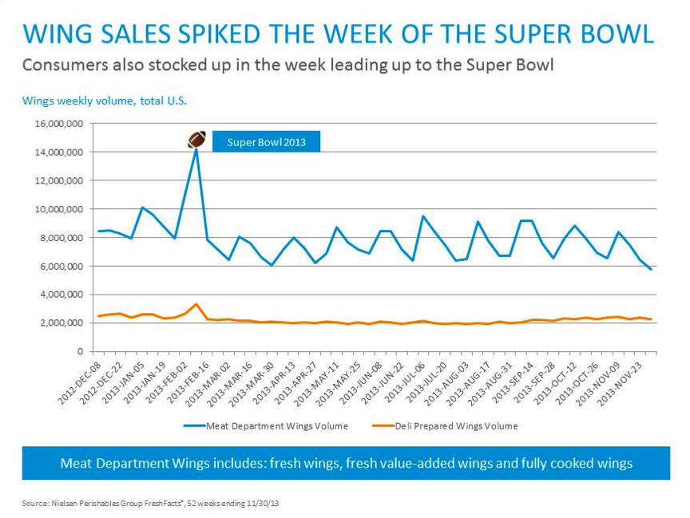
Why include covariates in a model?
Most ecologists are interested in explaining observed patterns
Covariates can explain the process that generated the patterns
http://www.nationalchickencouncil.org/

Slide 3
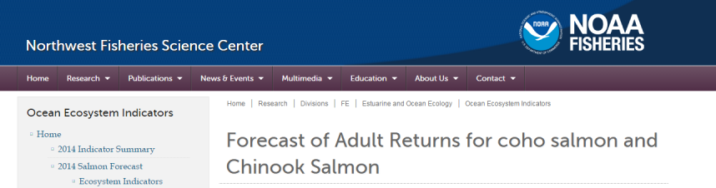
Why include covariates in a model?
You want to forecast something using covariates

Slide 4
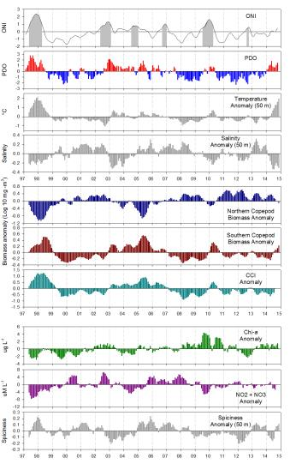
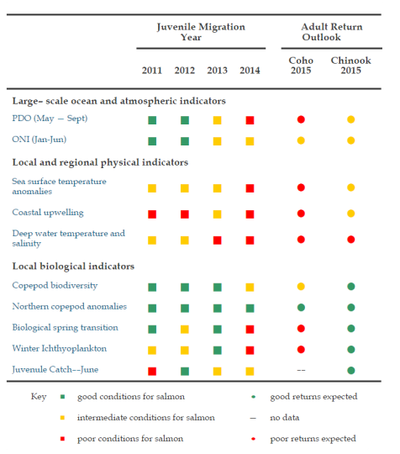
Covariates
Forecasts

Slide 5
Why include covariates in a model?
You want to explain correlation in observation errors across sites or auto-correlation in time
Auto-correlated observation errors
Model your v(t) as a AR-1 process
ug. hard numerically
Or if know what is causing the auto-correlation, include that as a covariate.
Correlated observation errors across sites (y rows)
Use a R matrix with off-diagonal terms
ouch! hard numerically
Or if know what is causing the correlation, include that as a covariate

Slide 6
Types of covariates
Numerical
Continuous (eg, temperature, salinity)
Discrete (eg, counts)
Categorical
Before/After
North/South
January, February, March, …

Slide 7
Covariates occur in state, obs or both
State equation
(eg, nutrients affects growth, high temps kill)
Observation equation
(eg, vegetation obscures individuals,
temperature affect behavior making animals visible)

Slide 8
Covariates occur in state, obs or both
State equation
k cols
1 col
m rows
x
k rows
c(t) are the covariates at time t
C is the effect of cov on state
m is number of states; k is number of covariates

Slide 9
Covariates occur in state, obs or both
Observation equation
k cols
1 col
n rows
k rows
D is the effect of cov on state
d(t) are the covariates at time t
n is number of obs; k is number of covariates

Slide 10
Covariate effects can differ or not
Different effects
Same effect

Slide 11
Covariates can be seasons or periods
State equation
Observation equation

Slide 12
Seasonal or periodical effects
For example, effects of “season” on 3 states (3 rows)
Winter
Spring
Summer
Autumn
Winter
Spring
Summer
Autumn
Winter
Spring
Summer
Autumn
t = 1 2 3 4 .....

Slide 13
Seasonal or periodical effects
For example, effects of “season” on 3 states
c_{t}

Slide 14
Seasonal or periodical effects
For example, effects of “season” on 3 states
c_{t+1}

Slide 15
Non-factor seasons or periods
Treating season as a factor means we have a parameter for each ‘season’. 4 in the previous example. What if the factor were ‘month’? Then we’d have 12 parameters!
We can also estimate “season” via a nonlinear model
Two common options:
Cubic polynomial
Fourier frequency

Slide 16
Season as a polynomial
For months:
m
m²
m³
t = 1 2 3 .....

Slide 17
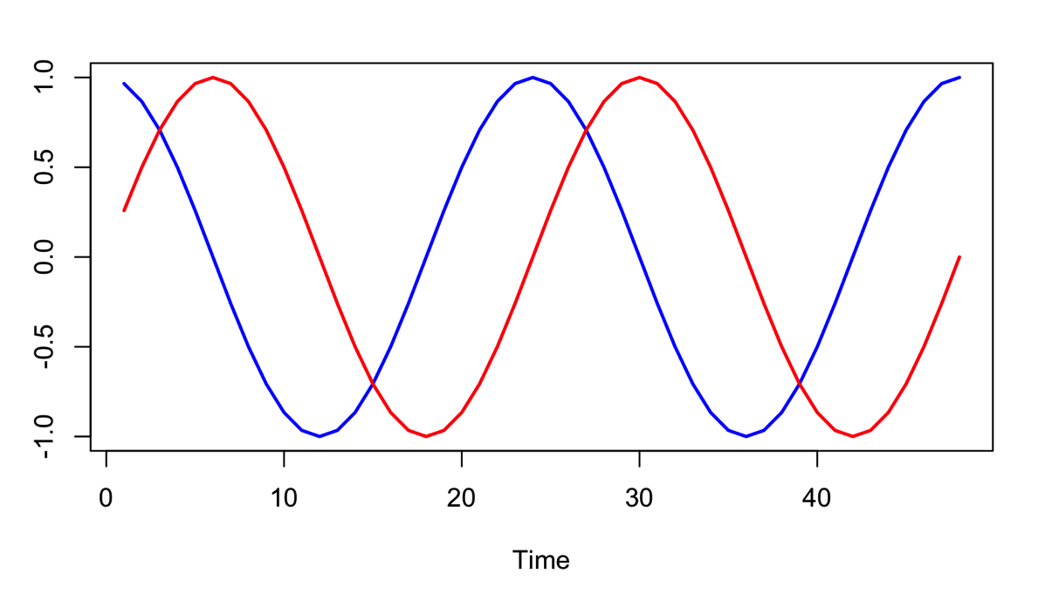
Season as a Fourier series
Fourier series are paired sets of sine and cosine waves
They are commonly used in time series analysis in the frequency domain

Slide 18
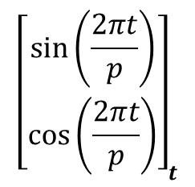
Season as a Fourier series
Our new covariates at time t
Cc_{t} = C₁sin(2πt/p) + C₂cos(2πt/p)
$${\left[\begin{matrix}sin⁡\left(\frac{2πt}{p}\right) \\ cos⁡\left(\frac{2πt}{p}\right)\end{matrix}\right]}_{t}$$
t is time step (1, 2, 3, ... , number of data points)
p is period (e.g., 12 months per year so p=12)

Slide 19
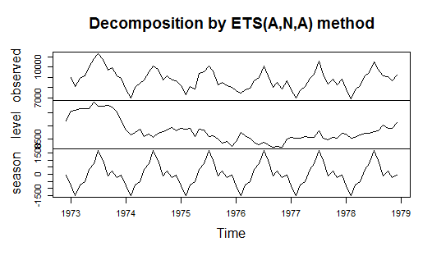
Contrast to other seasonal approaches
Multivariate linear regression: Same as MARSS
ARIMA: Remove season with seasonal differencing until your transformed data (differenced) is stationary.
Decomposition: Fit smoothed line (e.g. via filter or loess) to season to get a seasonal trend or use average.
Exponential smoothing: seasonal component is smoothed (weighted average) from prior seasons

Slide 20
Dealing with missing covariates in a MARSS (multivariate state-space) framework
Drop years / shorten time series to remove missing values
Interpolate missing values
Develop a process model for the covariates
Allows us to incorporate observation error into the covariates (known or unknown)
Allows us to interpolate but NOT treat that interpolated value as known. It is an estimated value that has uncertainty.

Slide 21
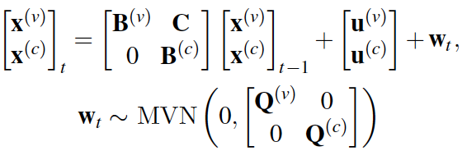
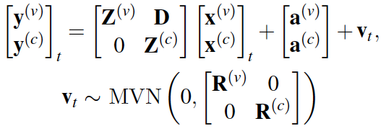
One MARSS model with both response variables and covariates
(v) are the response variables (data)
(c) are the covariates

Slide 22

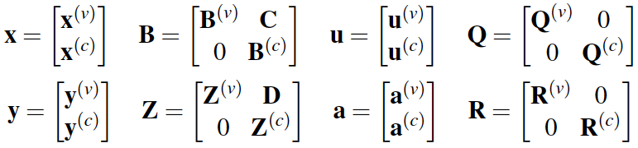
One MARSS model
See Holmes, Ward and Scheuerell (2018) “MARSS User Guide” for a discussion and example of how to do this.

Slide 23
Topics for the computer lab
Fitting multivariate state-space models with covariates
Seasonal effects

